Slide 1
Employee Data Analysis using Excel
STUDENT NAME: PARKAVI . G
REGISTER NO: 312209217
DEPARTMENT: B.COM BANK MANAGEMENT
COLLEGE: ANNA ADARSH COLLEGE FOR WOMEN

Slide 2
PROJECT TITLE
Employee Performance Analysis using Excel

Slide 3


AGENDA
Problem Statement
Project Overview
End Users
Our Solution and Proposition
Dataset Description
Modelling Approach
Results and Discussion
Conclusion
3/21/2024 Annual Review

Slide 4

PROBLEM STATEMENT
To Track The Employee Performance For Focusing On Their Growth.
For High Level Performance Employee We Can Give Increments To Them.
For Low Level Performance Employee We Can Motivate Them For Better Outcome.
Effectively Considers Multiple Perspectives And Approches Before Making Decisions .
Displayed A Consistentely Strong Ability To Tackle Challenging Problems Efficiently.

Slide 5

PROJECT OVERVIEW
Analyzing The Performance Of The Employee By Considering Various Factors Like Gender, Performance Score, Ratings, achievements.
Performance Analysis In Order To Identify The Trends And Patterns Of Different Categories Of Employees Like High, Medium and Low
Compare Strengths And Weaknesses of employees.
Recommend Actionable Goals.

Slide 6
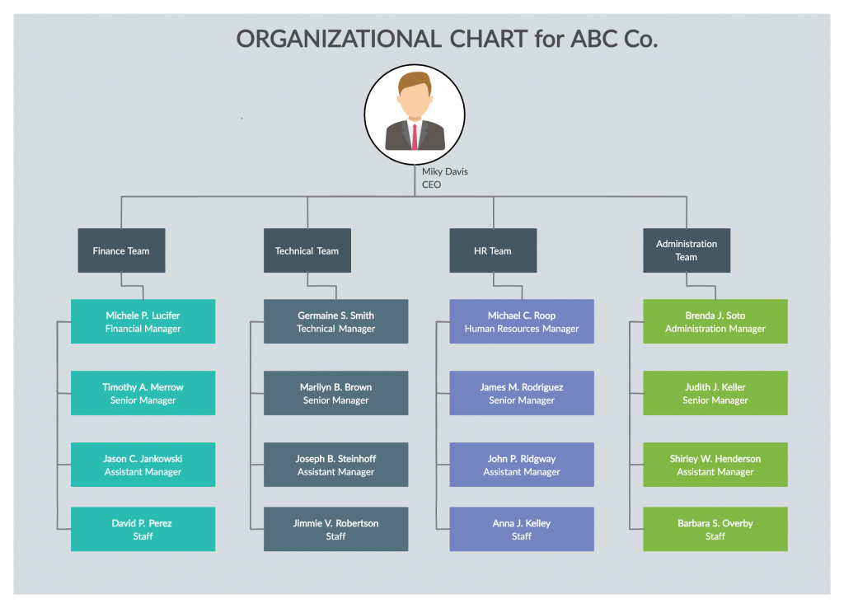

WHO ARE THE END USERS?

Slide 7

OUR SOLUTION AND ITS VALUE PROPOSITION
CONDITIONAL FORMATTING – MISSING
FILTER – REMOVE
FORMULA – PERFORMANCE
PIVOT – SUMMARY
GRAPH – DATA VISUALIZATION

Slide 8
Dataset Description
EMPLOYEE DATASET – KAGGLE
26 FEATURES IN THAT WE CONSIDER ONLY 9 FEATURES IN THE DATA
EMP ID – NUMBER
FIRST NAME AND LAST NAME – TEXT
GENDER – MALE AND FEMALE
PERFORMANCE LEVEL – TEXT
BUSINESS UNIT – TEXT
NAME – TEXT
RATING – NUMERICAL DATA

Slide 9

THE "WOW" IN OUR SOLUTION
PERFORMANCE LEVEL =
IFS(Z8>=5"VERY HIGH",Z8>=4"HIGH",Z8>=3,"MED",TRUE,"LOW")
3/21/2024 Annual Review
9

Slide 10
MODELLING
DATA COLLECTION
KAGGLE TO DOWNLOAD THE DATA
FEATURE COLLECTION
Employee Status
Employee Type
Gender Code
Performance Score
Current Employee Rating
DATA CLEANING
MISSING VALUE IDENTIFY
MISSING VALUE FILTER OUT
PERFORMANCE LEVEL
CURRENT EMPLOYEE LEVEL
IFS FORMULA
SUMMARY
PIVOT TABLE
GRAPH
10

Slide 11
RESULTS

Slide 12
RESULTS
12

Slide 13
conclusion
By comparing the performance of the employees the number of employees are higher in number.
Very high performance of the employees are very low so we need to motivate the employees.
By giving them them different levels of task based on their strength and performance for better outcome.

